Slide 2

Dream
Instructor
Members
Course
Project
Travels

Slide 3
(Application of Information and Communication Technology)
AICT - Lab
Course
Dream
Travels
Instructor
Project
Members

Slide 4
T.A: Mr.Mudassir
Ms.Ramsha Khalid
Course
AICT - Lab
Dream
Travels
(Application of Information and Communication Technology)
Instructor
Project
Members

Slide 5
Course
Ms.Ramsha Khalid
Instructor
Project
T.A: Mr.Mudassir
Members
Anass Shafi Shahid
M.Ali Amir
M.Salahuddin
M.Amar Rasheed
M.Uzair
Huda Shahzadi

Slide 6
Course
Anass Shafi Shahid
M.Ali Amir
M.Salahuddin
M.Ammar Rasheed
M.Uzair
Huda Shahzadi
Instructor
Project
Members

Slide 7




Course
Anass Shafi Shahid
M.Ali Amir
M.Salahuddin
M.Amar Rasheed
M.Uzair
Huda Shahzadi
Instructor
Project
Members

Slide 8


Slide 9
INTRODUCTION
A travel agency helps customers plan and arrange trips by providing travel and booking services.

Slide 10
INTRODUCTION
Purpose
The purpose of this project is to understand website development by creating a functional travel agency website and preparing proper project documentation.
A travel agency helps customers plan and arrange trips by providing travel and booking services

Slide 11
Purpose
The purpose of this project is to understand website development by creating a functional travel agency website and preparing proper project documentation.
INTRODUCTION
Importance
Provides easy access to travel information
Saves time for customers and agencies..
Helps reach more customers online.
A travel agency helps customers plan and arrange trips by providing travel and booking services

Slide 12


Purpose
The purpose of this project is to understand website development by creating a functional travel agency website and preparing proper project documentation.
INTRODUCTION
A travel agency helps customers plan and arrange trips by providing travel and booking services
Solution
Traditional problem
Importance
Traditional travel agencies rely on manual inquiries and bookings.
Customers must visit offices or make phone calls for information.
Limited working hours reduce customer convenience.
There is a need for an online platform to provide travel details easily and quickly.
Provides easy access to travel information
Saves time for customers and agencies..
Helps reach more customers online.

Slide 13
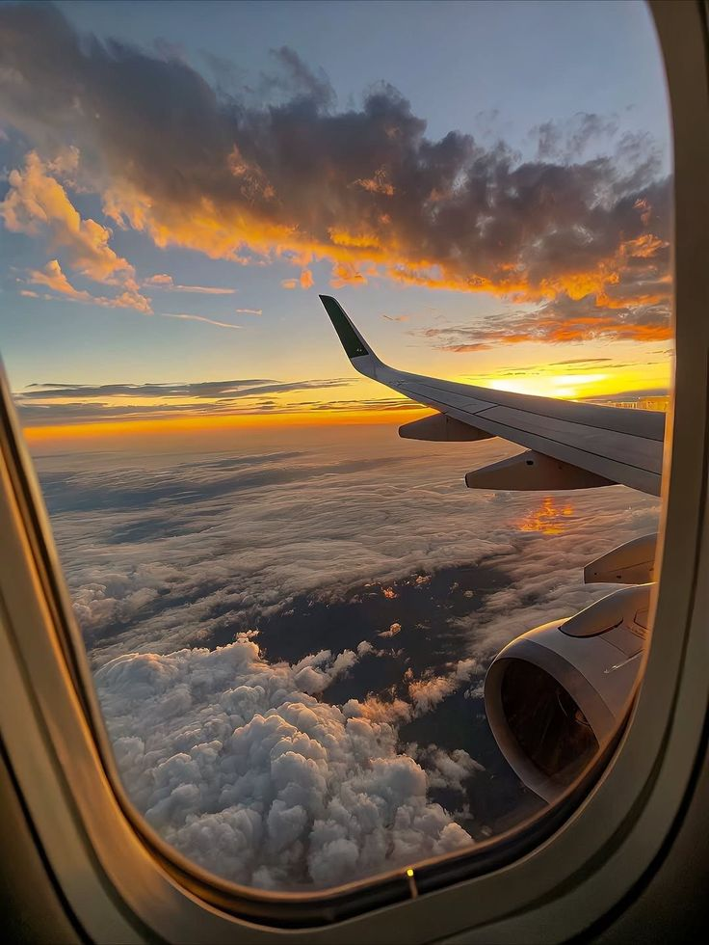

Objective
Create a simple travel agency website using HTML.
Display travel destinations and tour packages.

Slide 14
Objective
Scope of project
Create a simple travel agency website using HTML.
Display travel destinations and tour packages.
Target Users: Travelers and customers looking for tour information.
Included Features: Travel destinations, tour packages, and contact details.
Not Included: Online payment system and database connectivity.

Slide 15
Scope of project
Website Structure
Target Users: Travelers and customers looking for tour information.
Included Features: Travel destinations, tour packages, and contact details.
Not Included: Online payment system and database connectivity.
Objective
Create a simple travel agency website using HTML.
Display travel destinations and tour packages.

Slide 16
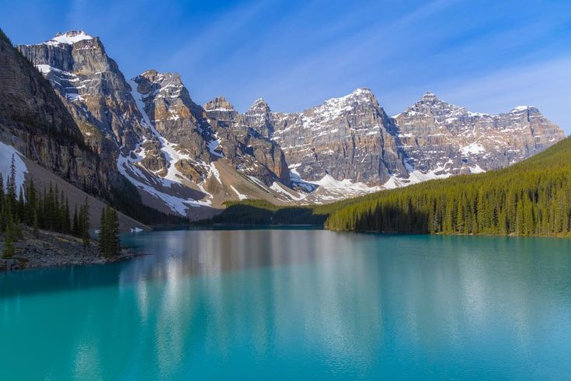




Website Structure
Home
Packages
Privacy
Destination
Contact

Slide 17
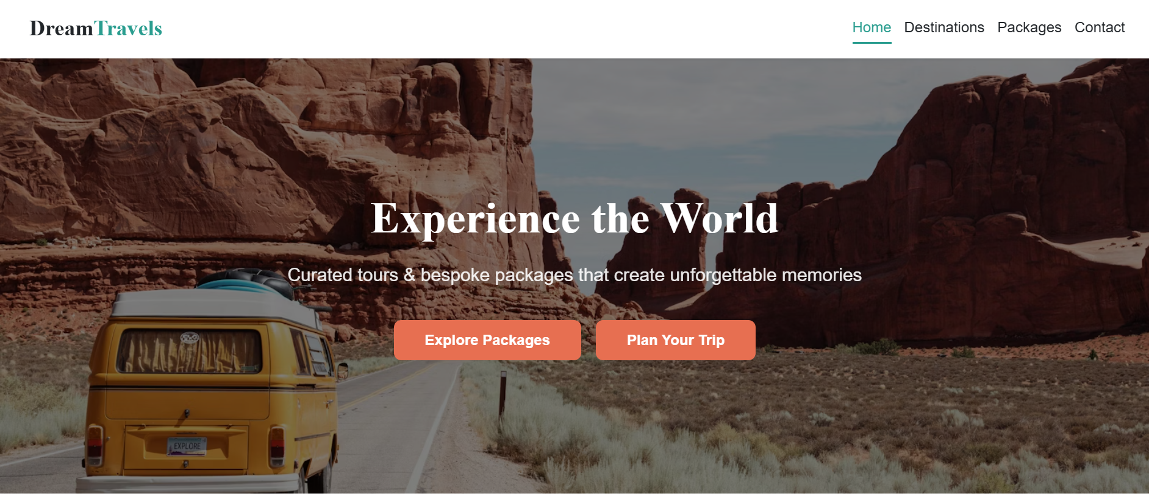
Website Structure
Home Page
Scope of project
It is the main page of travel agency
Target Users: Travelers and customers looking for tour information.
Included Features: Travel destinations, tour packages, and contact details.
Not Included: Online payment system and database connectivity.
Packages
Contact
Home
Privacy
Destination

Slide 18
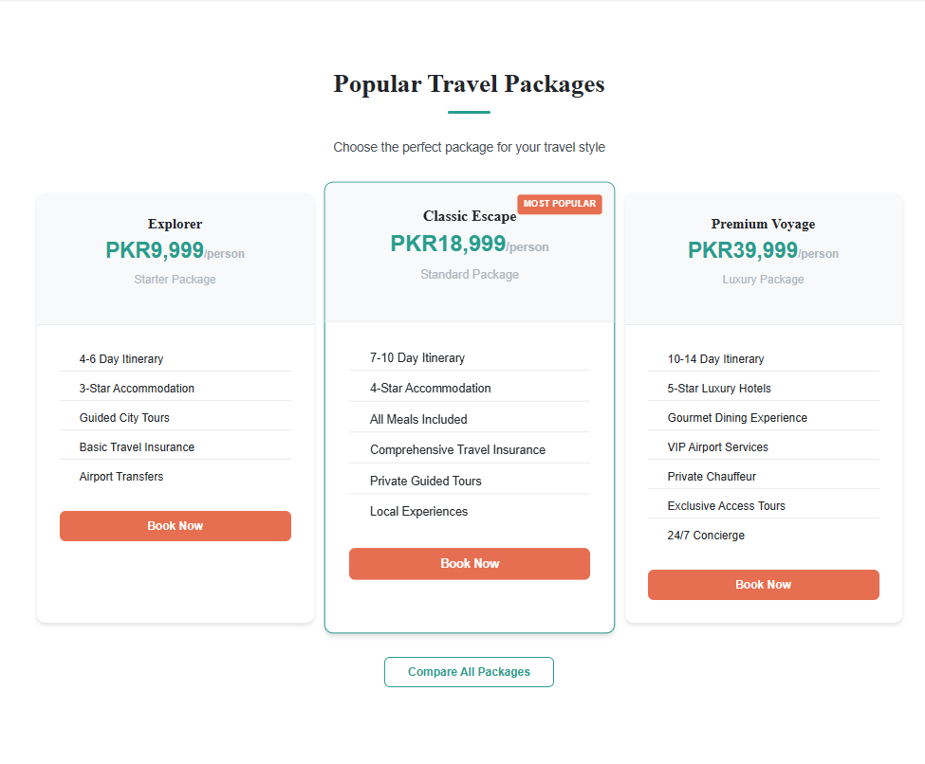
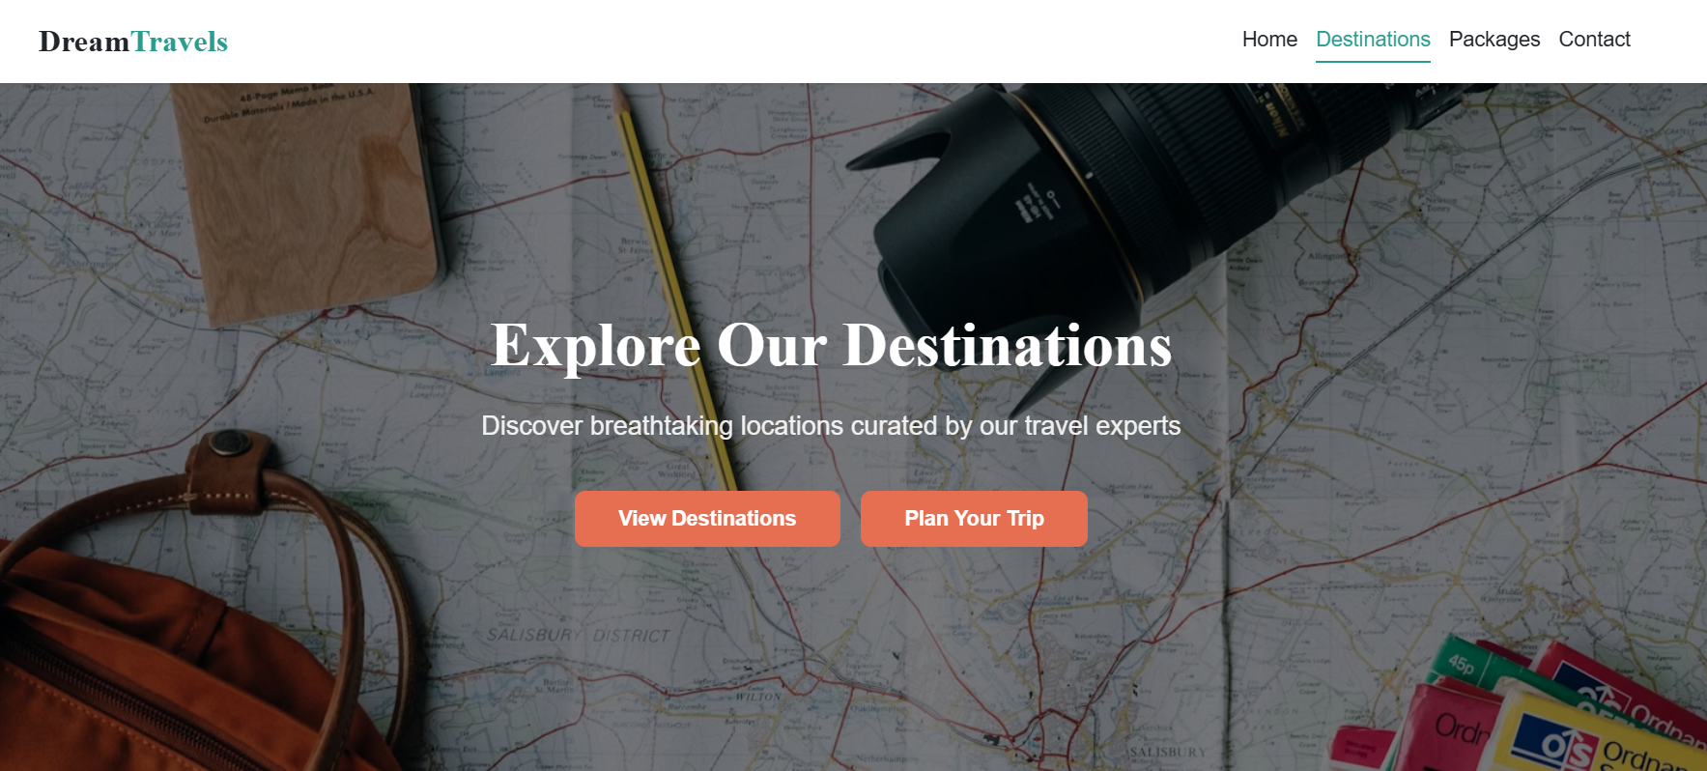
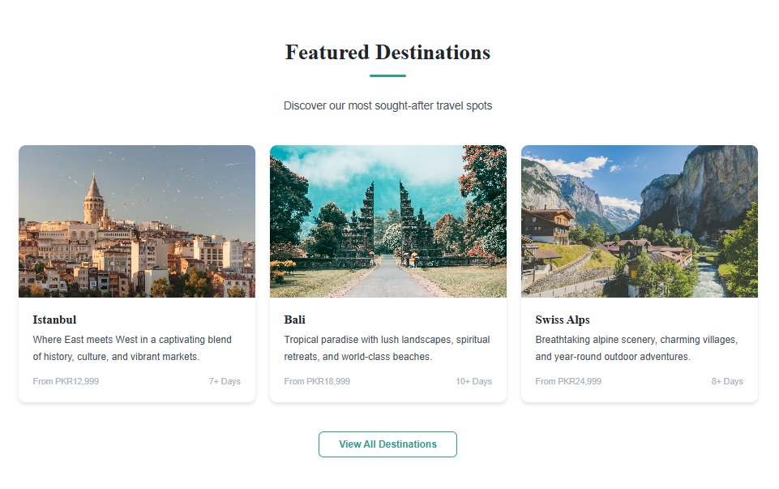
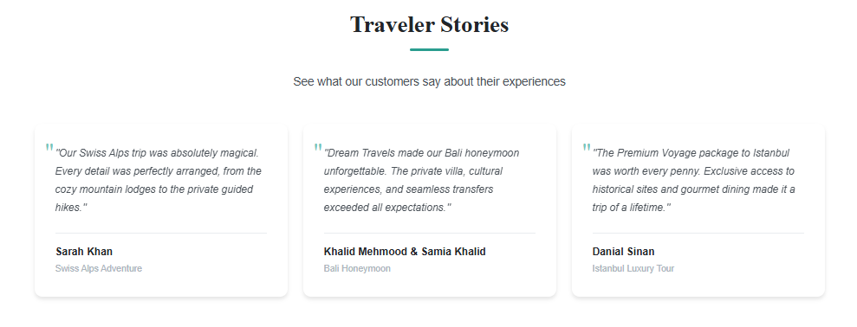
Website Structure
Destination Page
Home Page
It is the main page of travel agency
Contains navigation menu
highlights key services such as tour packages
Packages
Contact
Featured Destinations
Home
Privacy
Travelers Stories
Destination

Slide 19
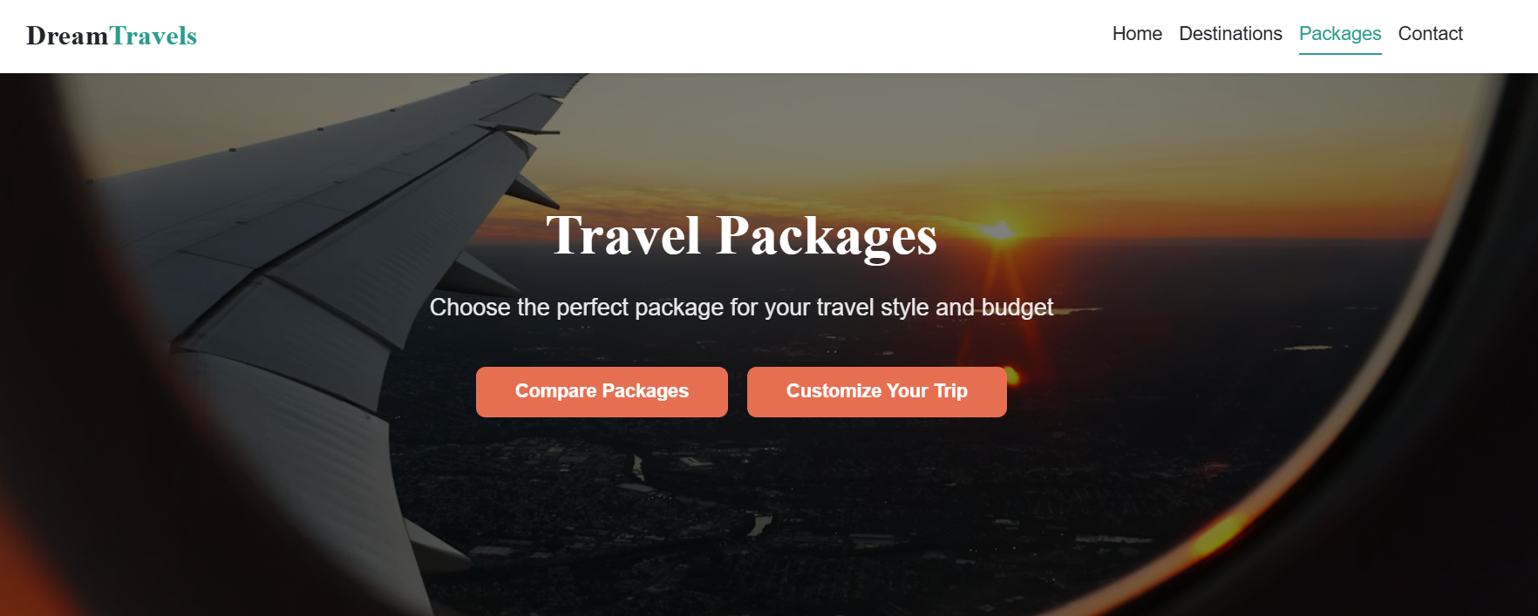
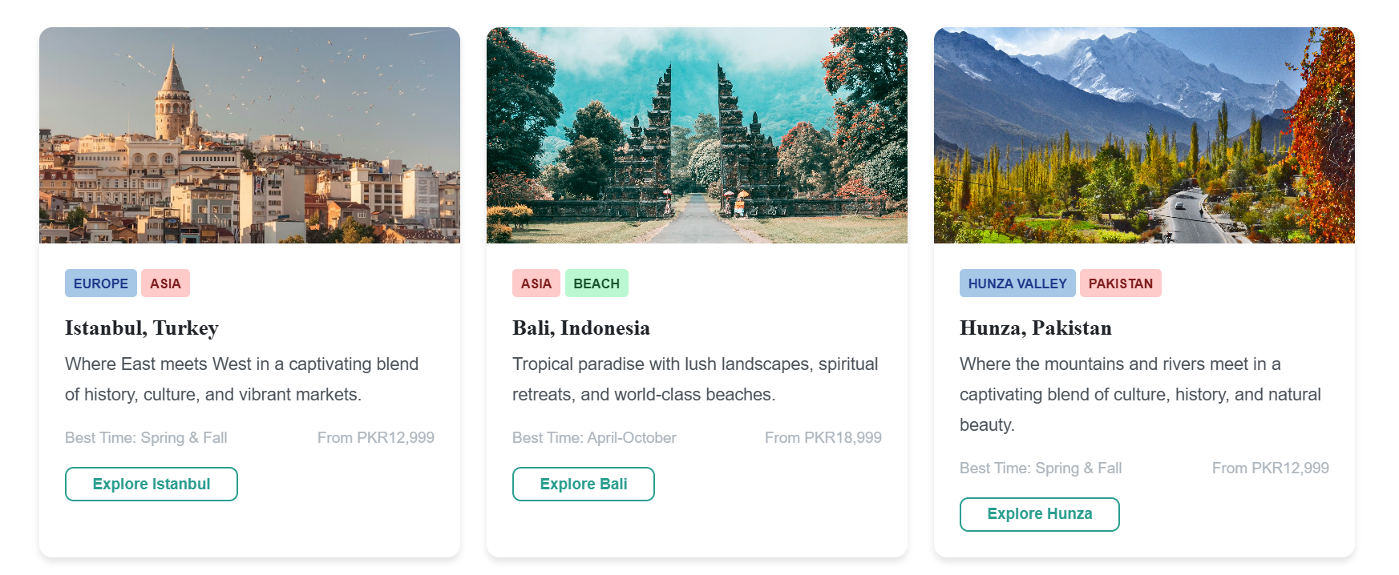
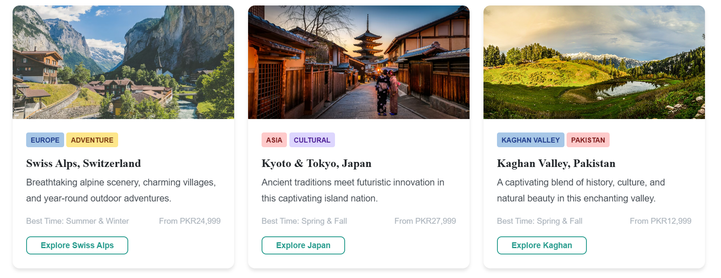
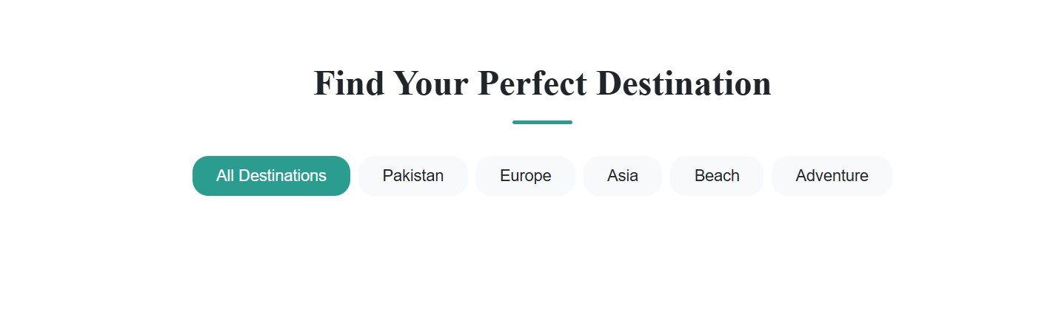
Website Structure
Home Page
Create a simple travel agency website using HTML.
Display travel destinations and tour packages.
Packages Page
Destination Page
Privacy
It is the main page of travel agency
Popular destinations
Contains navigation menu
Includes images of each destination to attract users.
Contact
highlights key services such as tour packages
Packages
Provides brief information about locations and attractions
Featured Destinations
Destination
Travelers Stories
Home

Slide 20
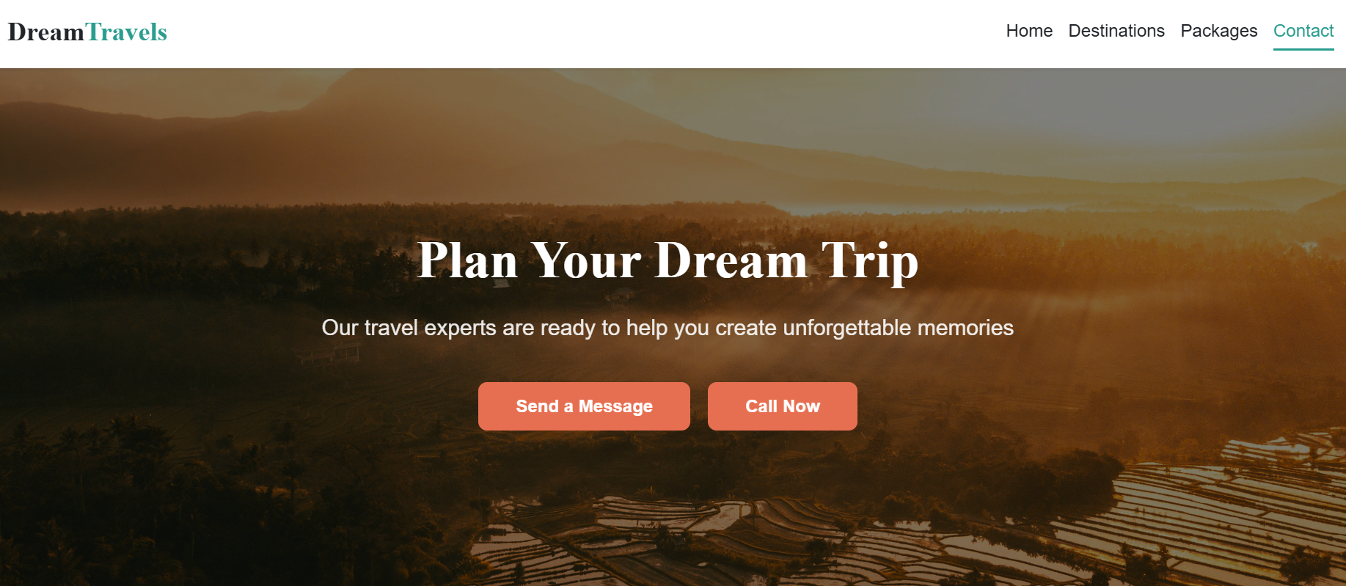
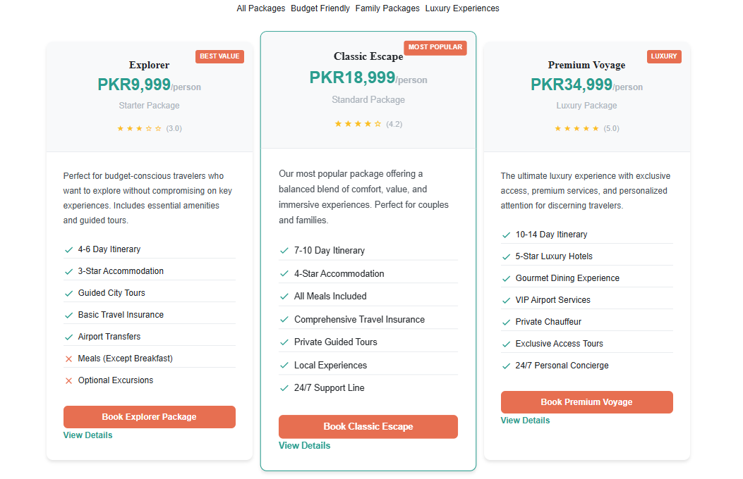
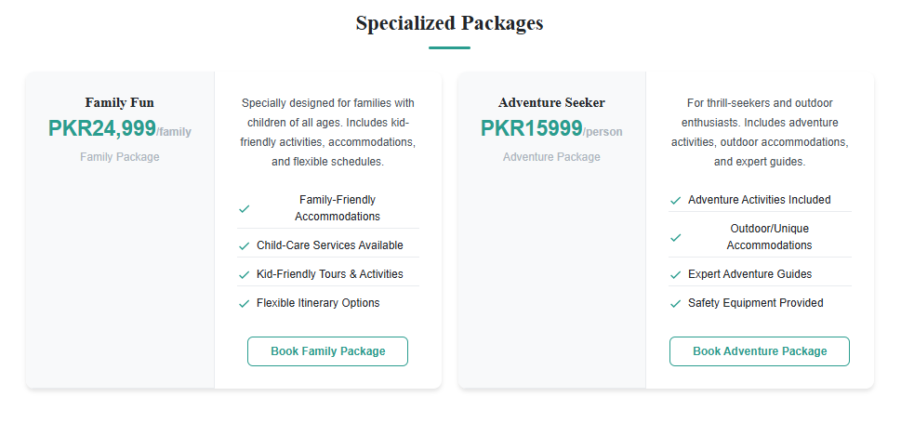
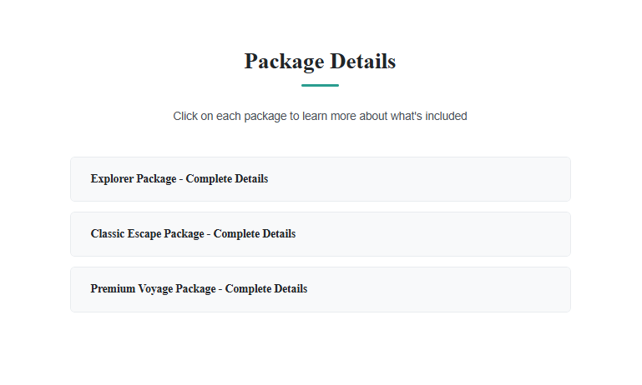
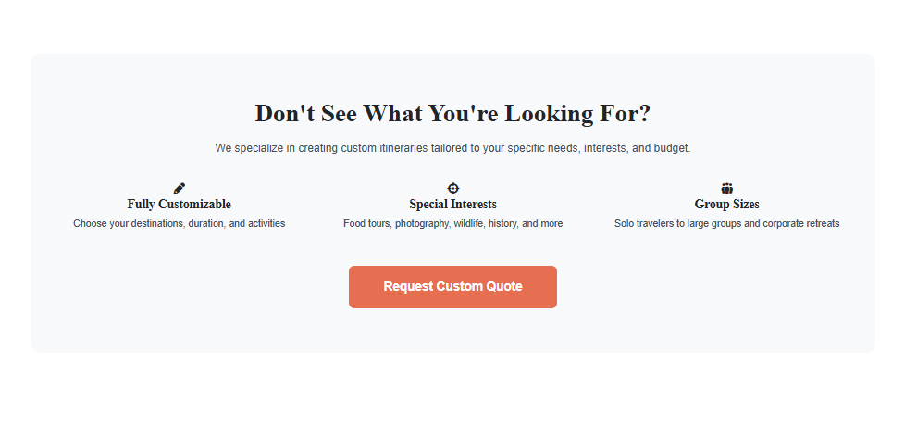
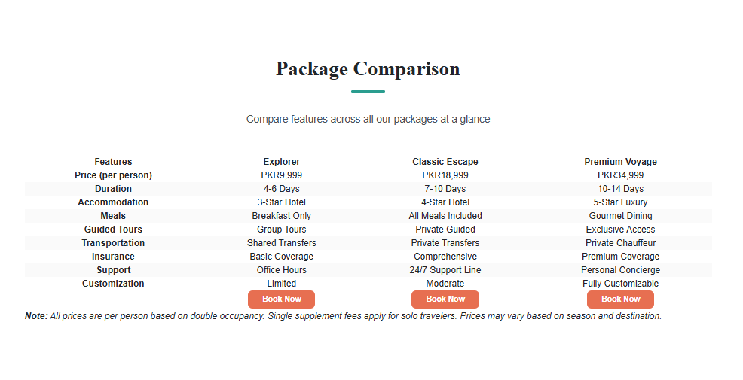
Website Structure
Contact page
Packages Page
Privacy
Signature Packages.
Specialized Packages.
Contact
Comparison of Packages.
Packages Details.
Packages
Custom Package
Home
Destination

Slide 21
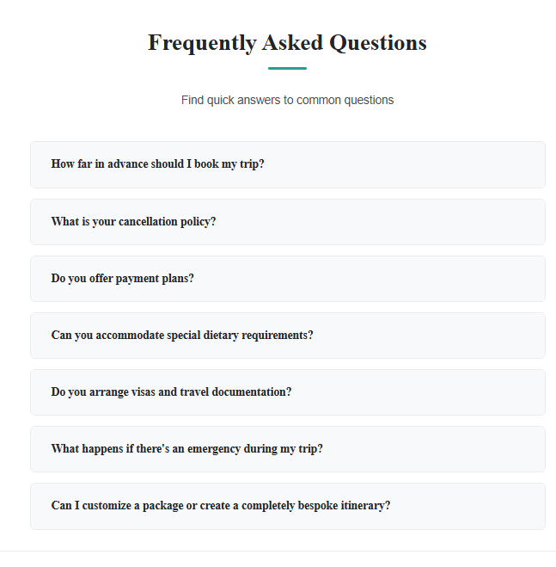
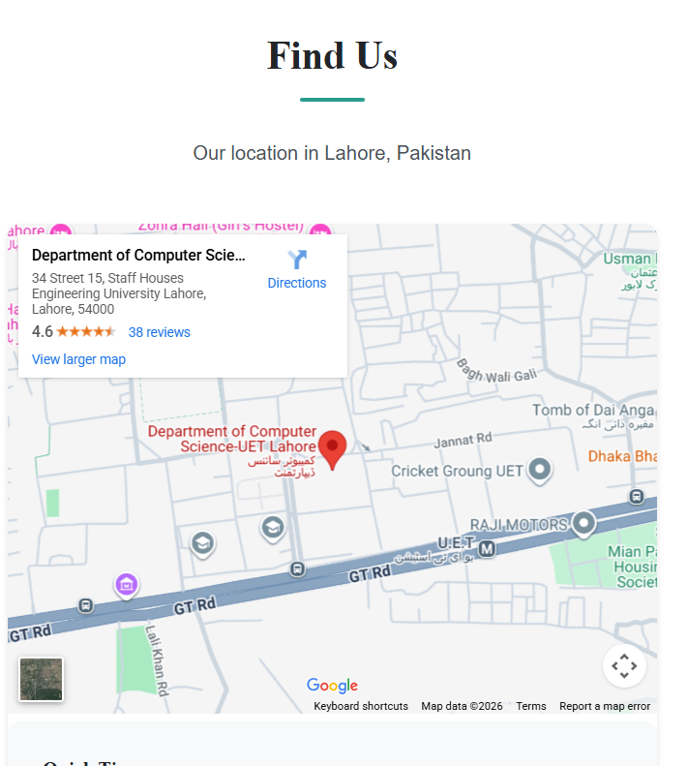
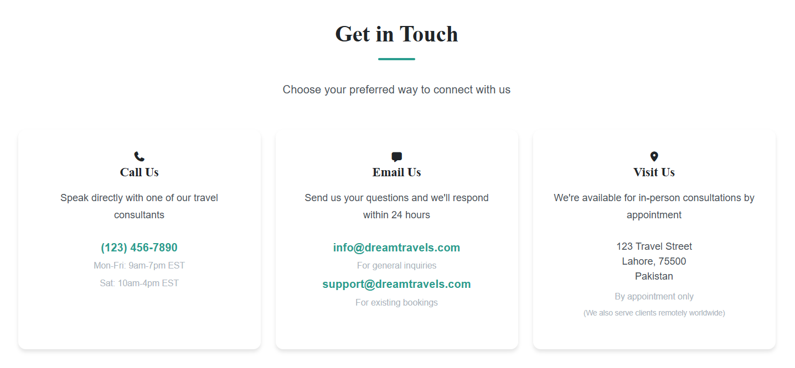
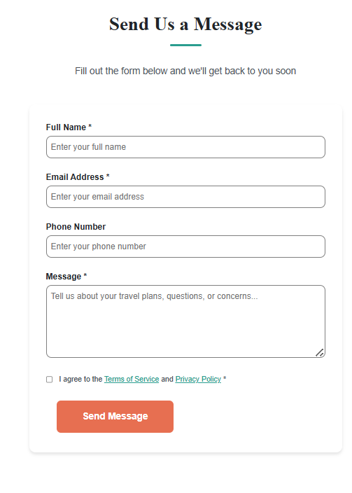
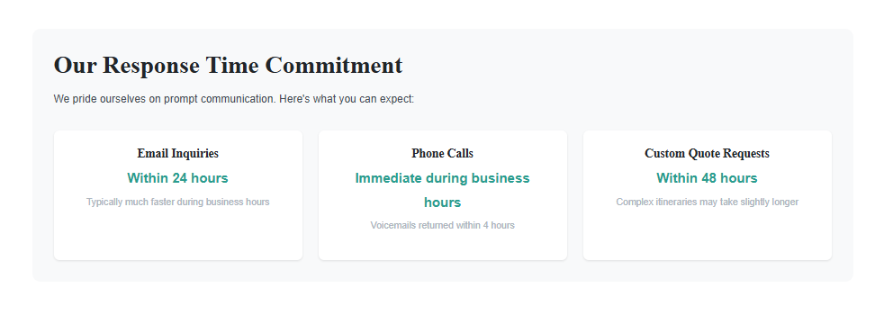
Website Structure
Packages
Scope of project
Contact page
Signature Packages.
Privacy
Different ways to contact us.
Specialized Packages.
Send a message or find our location
Contact
Comparison of Packages.
Packages Details.
Frequently asked questions.
Custom Package
Response time.
Home
Destination

Slide 22
Excel and Word Document
X
W

Slide 23
W
Excel and Word Document
X

Slide 24
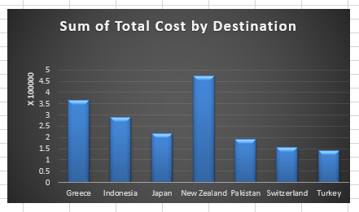
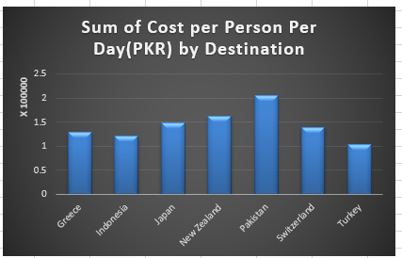
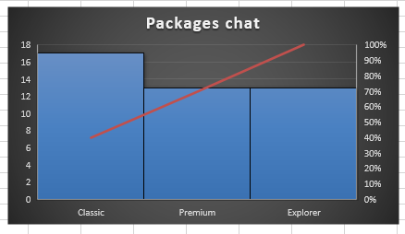
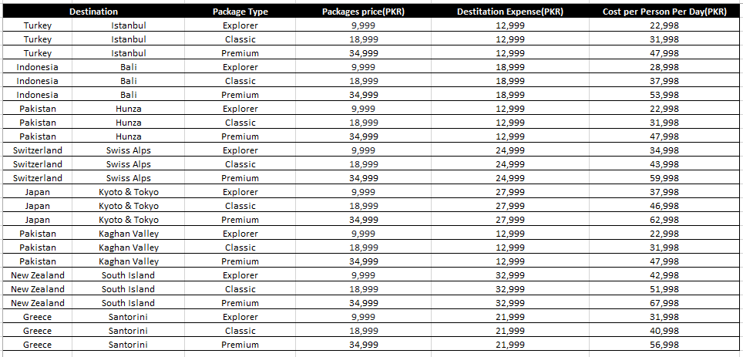
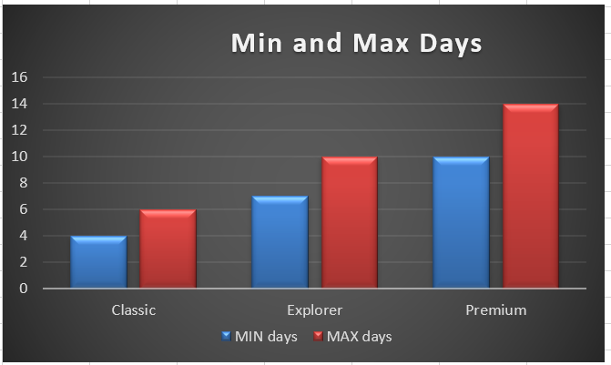
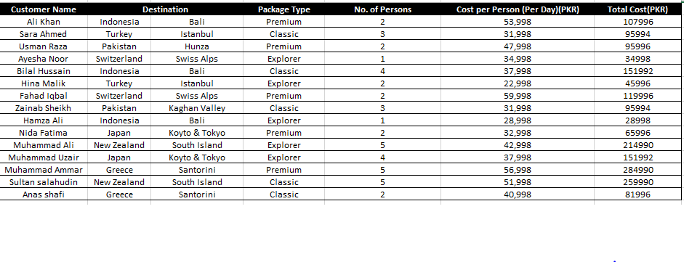
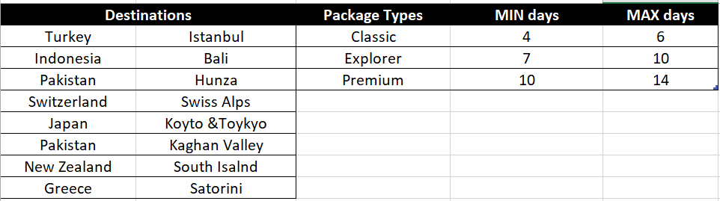
Excel Document
W
Used to store travel package in tabular form.
Contains package name, price and duration.
Maintains customer booking
X

Slide 25

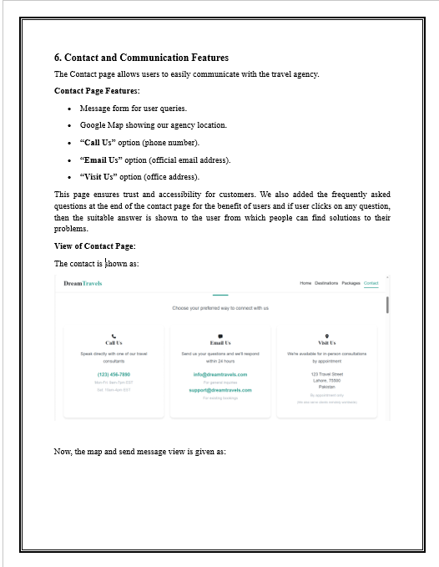
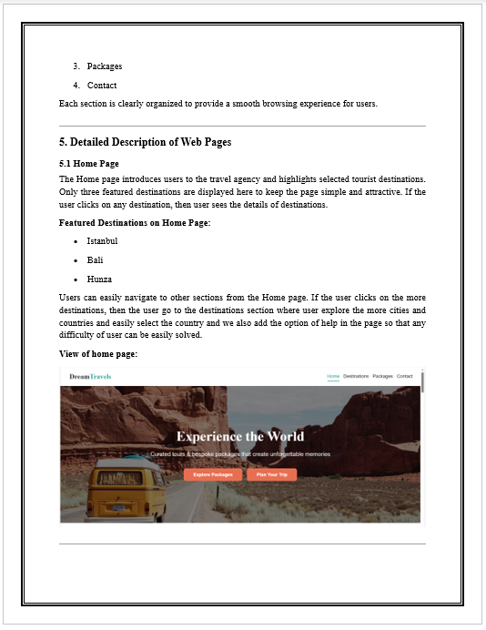
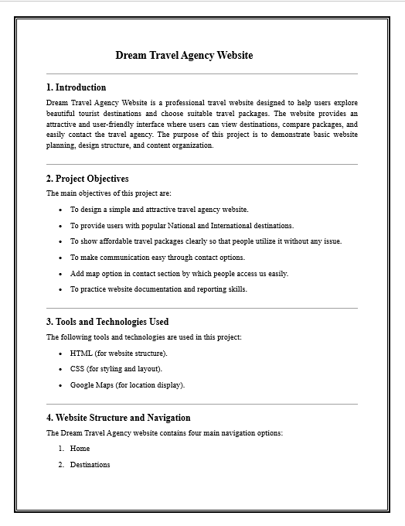
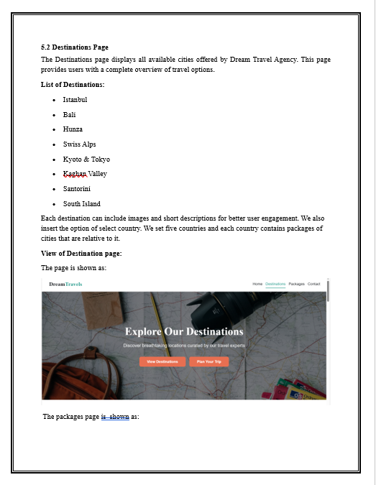
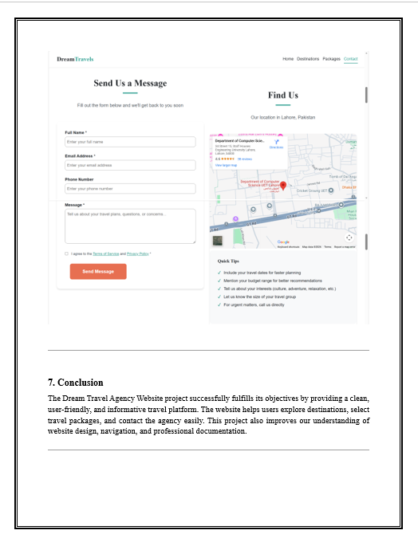
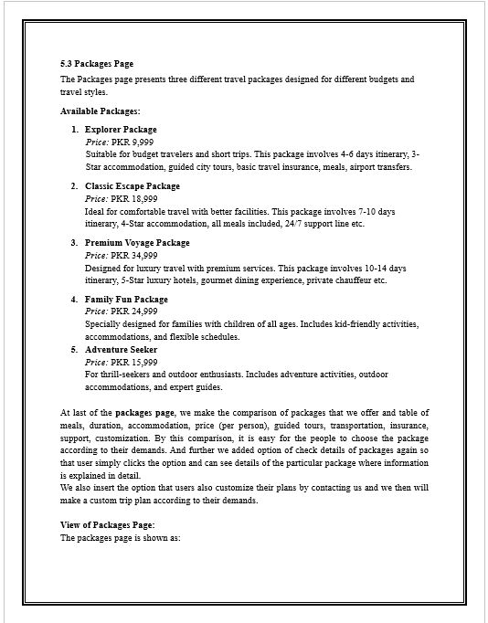
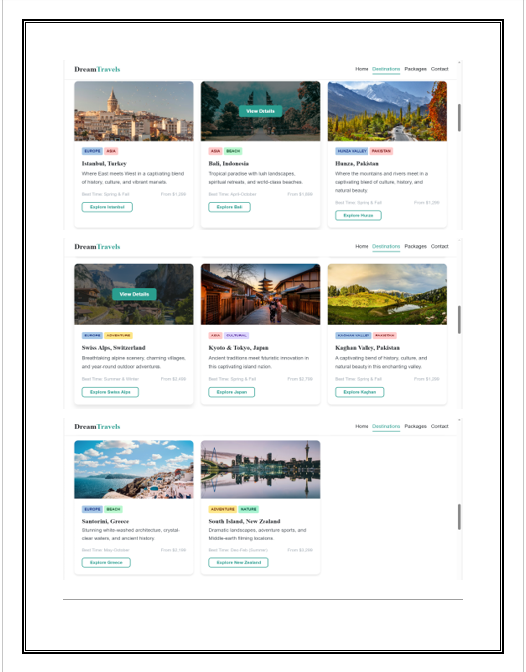
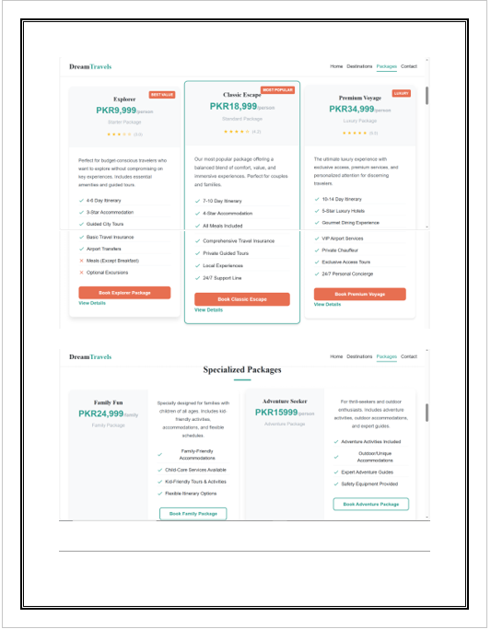
Excel and Word Document
Word
Document
W
Contains complete project documentation.
GITHUB
Explains each website page with screenshots.
Ends with project conclusion.
================URL here=============
X

Slide 26

W
GITHUB
THANK YOU
https://github.com/AICTL-Final-Project/AICTL-Final-Project.git
X
https://aictl-final-project.github.io/AICTL-Final-Project/website/index.html
Website link:

Slide 27
THANK YOU

